Slide 1
AI Fundamentals for Healthcare
Session 4 of 4 — From Models to Agents
Adapted from Harnessing AI Responsibly and Wisely
cair.ca

Slide 2
Where We Got To
Session 1: what a model is, and how training works.
Session 2: the classical model families, and how to tell whether one works.
Session 3: deep learning, large language models, and what deployment demands.
Today the model stops answering and starts acting.
  An agent is given a goal, and works toward it using tools
  That single change moves almost every risk you have met so far
The organising idea for the hour is the harness: the thing that makes power usable.
Notes:
Two minutes. The room should leave this slide understanding that today is about a change in kind, not a change in degree.
An LLM that answers is a tool you use. An agent that acts is something you are accountable for.

Slide 3
To Harness Means Two Things at Once
Harness, first sense — to bring under control
  Restrain raw power and make it safe. You harness a horse.
Harness, second sense — to put to powerful use
  Capture that power and do real work with it. You harness the power of AI.
These are not two ideas. They are one, and the control is what unlocks the power.
A plough horse, a climber on a cliff, a pilot in a storm. In each case the restraint is not the opposite of capability. It is the price of it.
Notes:
This is the spine of the session. Spend a minute on it and let the double meaning land.
The line worth saying slowly: the control is what unlocks the power. Clinical audiences already believe this about protocols; you are only naming it.
About 3 minutes.

Slide 4
Every Powerful Tool Comes With a Harness
The power
The harness
Excavation: forty tonnes of hydraulics
Aviation: jet engines and autopilot
Healthcare: potent drugs and surgery
Each of these was transformative, and each was lethal before the discipline around it matured.
Shoring, angle of repose, load limits. Work with the soil, never against it.
Checklists, two-pilot command, and a recorder that turns every failure into a lesson.
Protocols, surgical checklists, double-checks, doses scaled to the patient.
The discipline that makes the work safe is the same discipline that makes it effective.
Notes:
Your audience lives in the third row. Let them supply the examples: the surgical safety checklist, independent double-checks for high-alert drugs, weight-based dosing.
The closing point is the one that converts sceptics: a pilot's checklist is exactly why flying is both the safest and the fastest way to travel. Safety and capability are not in tension.
About 4 minutes.

Slide 5
The Same Principles, Now Your AI Harness
Respect the limits — design around where the model fails. It predicts, it does not know.
Standardise the process — a repeatable prompt-and-verify routine is a pre-flight checklist.
Keep a human in command — the model does the lifting, a person decides and owns the outcome.
Defence in depth — never one-and-done. Cross-check against a trusted source.
Certify the operator — know the tool and its limits before the stakes get high.
Scale to the stakes — more oversight as consequences grow. A clinic letter is not a diagnosis.
None of these are new to healthcare. They are the same six ideas, pointed at a new tool.
Notes:
Do not read all six. Pick the two that suit the room and let them carry it.
'Certify the operator' is the one most often missing in practice. Organisations deploy a tool and train nobody on its failure modes.
About 4 minutes.

Slide 6
Tool Calls Plus a Loop Equals an Agent
Add two things to a language model and it stops answering and starts pursuing.
First, tool calls. The model can request actions: read a record, query a database, send a message, run code. Output becomes capability.
Second, a loop. The model acts, sees the result, and decides what to do next. It repeats until the goal is met. One-shot becomes pursuit.
A simple loop is the basic shape. Real agents often run a graph, with branching paths, parallel sub-tasks and a merge back to a decision.
Everything else today — memory, skills, tools, identity — serves this one move.
Notes:
This is the definitional slide. If someone remembers one sentence, make it 'tool calls plus a loop'.
The word that matters is pursuing. A chatbot that is wrong produces a wrong sentence. An agent that is wrong produces a wrong sentence and then acts on it, repeatedly.
About 5 minutes.

Slide 7
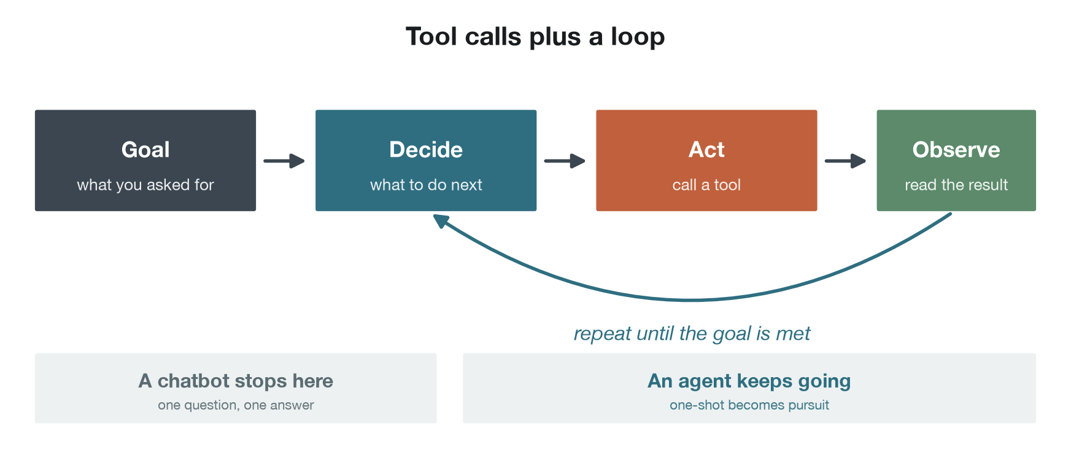
The Agent Loop
Notes:
Walk it once, left to right, then trace the return arrow with your finger.
The sentence that does the work: a chatbot stops at the first answer, an agent keeps going until the goal is met or it runs out of room to try.
About 2 minutes.

Slide 8
It Is Not the Model, It Is the Memory
A chatbot lives entirely inside its current window. An agent surrounds that window with four kinds of memory, modelled loosely on our own.
Working — what is in front of you now. The current conversation, files and instructions. Fast, and gone when the session ends.
Semantic — what you know. Durable facts, rules and local conventions.
Procedural — what you know how to do. Step-by-step skills, pulled in when a task needs one.
Episodic — what you have lived through. Distilled lessons from past sessions, so the same mistake is not made twice.
A chatbot is the first one only. An agent is the whole architecture around it.
Framework: Sumers, Yao, Narasimhan and Griffiths, Cognitive Architectures for Language Agents, 2024.
Notes:
The four-memory framing is the clearest way to explain why an agent behaves differently from a chatbot, and it maps onto how clinicians already think about knowledge and experience.
The episodic row is the one that surprises people: agents increasingly consolidate between sessions.
About 5 minutes.

Slide 9
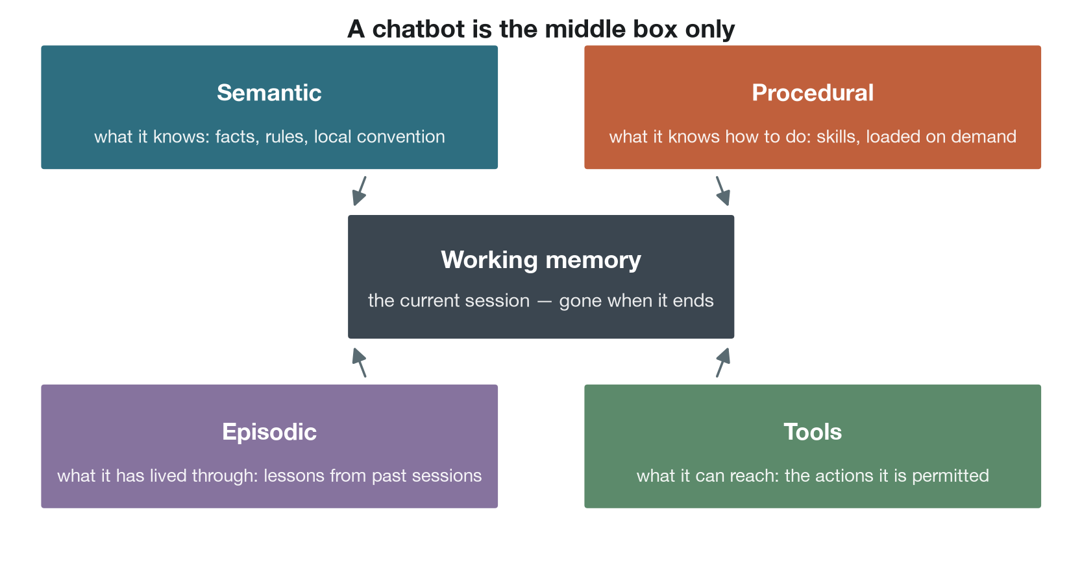
The Four Memories
Notes:
The working-memory box in the middle is the whole of a chatbot. Everything around it is what makes an agent.
Tools are included here deliberately: memory is what it knows, tools are what it can reach, and both are needed before a goal becomes action.
About 2 minutes.

Slide 10
How an Agent Acts on Your World
More structured, more auditable
More raw, more dangerous
A defined tool surface, such as the Model Context Protocol. Each tool exposes a named action: read the worklist, create a referral, book a slot.
Predictable inputs and outputs, and an audit trail you can read.
An application's own interface. Bounded to what that system already permits, and often needing no new integration.
Direct access to a terminal or a database. The agent can do anything an administrator could do.
Maximum power, maximum blast radius.
If you allow this, sandbox it, scope it to the minimum, and log everything.
In a clinical system, a defined tool surface is almost always the right answer.
Notes:
The spectrum is the point: structure buys you auditability, and raw access buys you capability you probably should not want.
For a hospital, the practical message is that an agent should act through a defined set of named actions, each of which a governance group can read and approve.
About 4 minutes.

Slide 11
Acting as You, or Acting as Itself?
When an agent does something in your systems, whose login did it use? This is an identity question, and it reshapes the audit trail, the blast radius and the accountability story.
Acting as you — it uses your credentials. Every action looks like yours. Easy to set up, and it needs no new permissions.
  But the audit log names you, it inherits all of your access, and revoking it means revoking yourself.
Acting as itself — its own service account, with least-privilege scopes. Actions are clearly attributable to the agent, and can be revoked independently.
  A named human still owns it.
Give the agent its own identity. Yours stays yours.
Notes:
This slide matters more in healthcare than almost anywhere, because the audit trail is a medico-legal record.
The sentence to land: the wrong choice quietly converts an audit trail into 'you did it', even when you did not.
Ask whether anyone knows, for a tool already in their organisation, which identity it acts under. Usually nobody does.
About 5 minutes.

Slide 12
The Lethal Trifecta
Access to private data — it can read the record, the inbox, the shared drive.
Exposure to untrusted content — it reads documents, referrals, web pages and email, any of which may carry hidden instructions.
A way to send data out — it can make requests, follow links, or send a message.
All three together is the exposure. A line buried in a document the agent reads can instruct it to find private data and send it elsewhere.
The fix is not a smarter filter. Detection is unreliable. Break the trifecta by removing any one leg.
Term coined by Simon Willison, 2025.
Notes:
This is the security slide, and it is the one most likely to change what somebody does on Monday.
The clinical version is concrete: an agent that can read the record, ingest a scanned referral from outside the organisation, and send email. Each is reasonable. Together they are an exfiltration path.
Do not let this become abstract. Name the three legs, then ask which one their proposed tool could do without.
About 6 minutes.

Slide 13
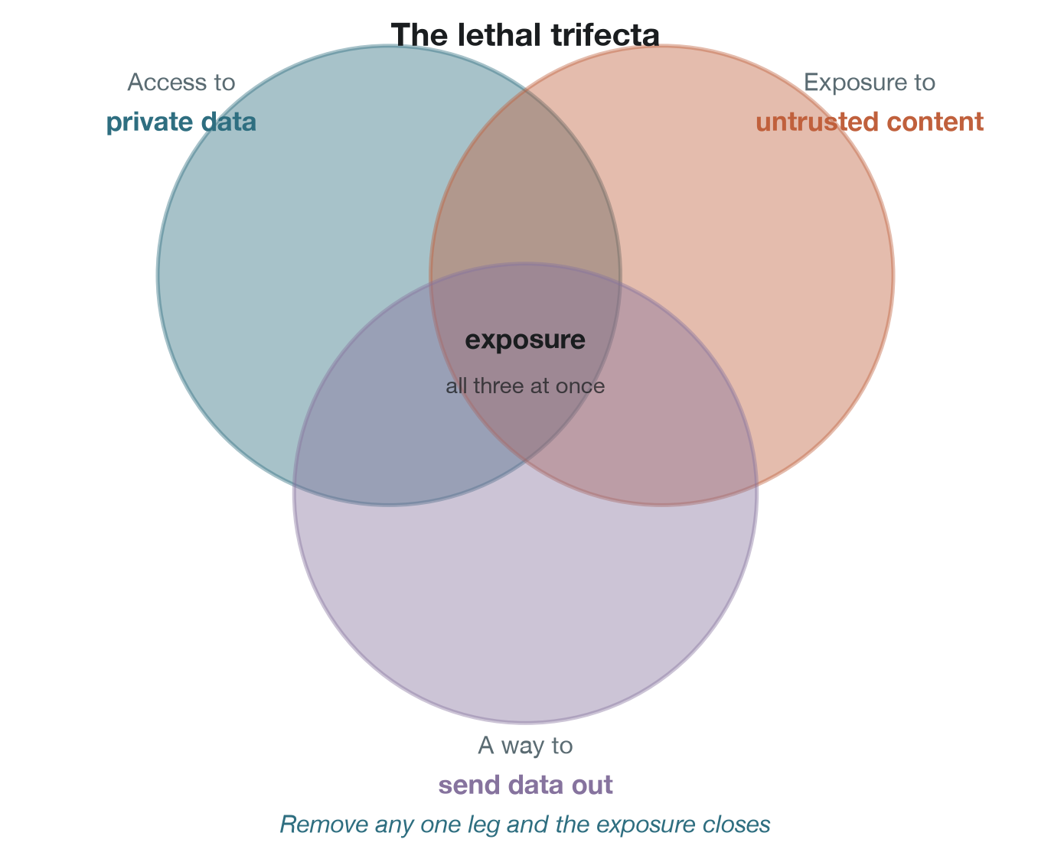
Breaking the Trifecta
Notes:
Point at each circle in turn and ask which one their proposed tool could do without.
In practice the easiest leg to remove in a hospital is the outbound path: an agent that can read the record and ingest documents, but cannot send anything outside the network, is a far smaller problem.
About 3 minutes.

Slide 14
It Knows the Work, Not the Workplace
A language model arrives like a new hire: skilled at the craft, and with no idea how anything is done here. Your systems, your data, your conventions, the unwritten rules.
So the exchange flips. You give the goal, and it tells you what it needs.
The agent that asks how things are done here is the safe one. The agent that assumes, and proceeds the generic way, is confidently wrong.
Local knowledge cannot ship with the model. It is learned on site.
Hayek called this the knowledge of the particular circumstances of time and place, 1945.
Notes:
Clinicians will recognise this immediately: it is the locum problem. Excellent doctor, no idea where anything is or how referrals work here.
The practical consequence is that most of the work in deploying an agent is writing down what your organisation never wrote down.
About 4 minutes.

Slide 15
Generate the Rule, or Make the Call?
The same model can sit in your workflow in two very different places, and the safety story is completely different.
Generate an artifact — ask for the protocol, the checklist, the query or the template. You review it once, and it then runs the same way every time.
  The unreliability is paid once, in a place you can audit.
Generate the answer — hand it the specific case and ask what to do. It decides afresh every time, including on the rare case it gets wrong.
  The unreliability is paid on every single call.
When the stakes are high, or the use is recurring, prefer the artifact. Push the unreliability to where you can inspect it.
Notes:
This is the sharpest practical idea in the session, and it is underused.
The clinical illustration: asking a model to draft a sepsis screening protocol that your team reviews and then follows, versus asking it about this patient at three in the morning. Same tool, entirely different risk profile, entirely different accountability.
About 5 minutes.

Slide 16
Work at the Right Altitude
The point of a harness is leverage. It keeps you at the altitude where you are irreplaceable: intent, judgement, accountability.
You will still drop to the ground sometimes, but only to supply what the agent is missing right now. A tool it does not have, or a fact only you know.
Those descents should be deliberate, brief, and marked. A good one teaches the agent, so you need not make the trip again.
Oversight is an altitude, not a checkbox. Looking at nothing and looking at everything until you stop seeing both end in the same place: false assurance.
Notes:
The second half is the part that resonates with clinicians, because rubber-stamping is a familiar failure. An alert everyone approves without reading is not oversight.
Connects directly back to the alert fatigue slide in Session 3.
About 4 minutes.

Slide 17
Green Does Not Mean Everything Is Fine
Tell a person they own something, and they are accountable for the cases nobody thought of too. A model is strong on the cases you named, and silent on the rest.
Silent, not uncertain. That is the problem.
Green means the things we are watching are fine. It never means everything is fine.
The real failure is not a red light. It is a green dashboard because nobody asked the right question. False assurance is worse than a visible gap, because it switches off your own vigilance.
The antidote: make the model list what it is not watching, and mark that as yours.
Notes:
A short slide with a long pause after it.
The antidote at the bottom is genuinely actionable and almost nobody does it. Ask the model what a responsibility like this usually involves, then compare that against what you are actually monitoring.
About 4 minutes.

Slide 18
Where Agents Fit in Clinical Work Today
Reasonable to pilot now
Not yet
Drafting a discharge summary from the record, for clinician review and signature
Assembling a case for a multidisciplinary meeting
Chasing missing results and flagging gaps before a clinic
Coding and billing preparation
Literature synthesis for a guideline review
Routine administrative workflow: booking, reminders, letters
Anything that acts on a patient without a person in between
Autonomous triage or escalation decisions
Prescribing, ordering or referring under its own authority
Anything reading untrusted external documents while holding record access
Anything whose errors are invisible until the outcome
The pattern is the same one from Session 3: a person reviews every output, and an error costs a correction rather than harm.
Notes:
Expect disagreement about the boundary, and let it run. That argument is the most useful thing the room can do with this hour.
The left column is deliberately unglamorous. Almost all of the realised value so far is administrative, and saying so keeps expectations honest.
About 6 minutes.

Slide 19
How Do You Test Something That Is Not Deterministic?
A classical model gives the same answer to the same input. An agent may not, and that breaks how we usually validate.
What to do instead:
  Build a fixed set of cases with known good outcomes, and run them repeatedly. Measure how often it succeeds, not whether it succeeded once.
  Test the failures deliberately. Feed it the ambiguous case, the missing data, the contradictory instruction, the document with something hidden in it.
  Log every action, not just the final answer. With an agent, the path matters as much as the destination.
  Watch the intervention rate. How often does a human have to step in, and is that number moving?
Run it silently alongside real work before anyone relies on it. That principle from Session 2 has not changed.
Notes:
This slide has no counterpart in the source material and is worth adding, because it is the first question a quality or governance lead will ask.
The honest position is that evaluation of agents is immature. Say so. Nobody in the field has this fully solved.
About 5 minutes.

Slide 20
Before You Trust It, Ask
Trustworthy is not a label a tool wears. It is whether you can answer a handful of basic questions about it.
Where does my data go? Stored, used for training, seen by whom, kept how long? If you cannot answer, do not put anything in it you would not post publicly.
What can it reach, and what can it send out? A tool that reads your data and can talk to the outside is a different risk from a plain chatbot.
Are we allowed to use it here? Organisational policy, sector regulation, contracts, confidentiality. Free online is not the same as approved for this work.
Can we show what it did, and who is answerable? Logs, reproducibility, and a named human who owns the outcome when it goes wrong.
Notes:
Offer this as a takeaway rather than reading it. It pairs with the deployment checklist from Session 3.
The third question is the one that catches people. Plenty of clinical staff are already using tools nobody approved.
About 4 minutes.

Slide 21
Session 4 — What to Take Away
An agent is a model plus tools plus a loop. That single change turns an answer into an action.
The harness is not a brake on capability. It is the thing that makes capability usable.
Give the agent its own identity, so your audit trail stays yours.
Break the lethal trifecta. Private data, untrusted content and an outbound path must not all meet in one place.
Prefer generating the rule over making the call, wherever the stakes are high.
Green means the things you are watching are fine. Nothing more.
Capability is delegable. Accountability is not.
Notes:
Close on the last line and stop talking.
It is the sentence that ties all four sessions together, and it is the one worth them repeating to a colleague who was not here.
About 4 minutes.

Slide 22
Further Reading
Sumers, Yao, Narasimhan and Griffiths (2024). Cognitive Architectures for Language Agents. The four-memory framework used here.
Hayek, F. A. (1945). The Use of Knowledge in Society. On why local knowledge cannot be centralised, or shipped with a model.
Polanyi, M. (1966). The Tacit Dimension. On knowing more than we can tell, which is why specifying intent is the hard part.
Autor, D. H. (2014). Polanyi's Paradox and the Shape of Employment Growth.
Willison, S. (2025). The Lethal Trifecta. The security framing used in this session.
From earlier sessions: TRIPOD+AI (2024) for reporting a clinical prediction model, and Obermeyer et al. (Science, 2019) on how a proxy label encodes inequity.
Notes:
Leave it on screen during questions. People photograph this slide.

Slide 23
Questions
Capability is delegable. Accountability is not.
Thank you.
Notes:
Final slide of the series. Worth saying that Sessions 1 to 4 are a set, and the quantum session is offered separately as a standalone.

